Slide 1
Rewriting of Plain SO Tgds into Nested Tgds
Rihan Hai (RWTH Aachen University), Christoph Quix (Hochschule Niederrhein & Fraunhofer FIT)
August 29, 2019
Slides: http://dbis.rwth-aachen.de/cms/projects/data-lake/
Notes:
Quix: Don’t start from iop; even a quick through from data lake;
But emphasize on the practical impact of so tgds.
18min in total: 12-15min at most

Slide 2
Agenda
Introduction
Running Example
Our Approach
System Evaluation
Conclusion
Q&A

Slide 3


Introduction
Schema Mapping
Describe the relationships between different schemas
Intensively studied for data exchange and data integration
Often expressed as logical sentences
Missing values and grouping behavior can be represented by Skolem Functions
Mapping Languages
Second-order mapping formalism
Higher expressive power
Higher data complexity of the model checking problem
Undecidable for logical equivalence problem
Less user-friendly
Notes:
Source-to-Target tgds (s-t tgds)
φ and ψ refer to source and target only
Second-order tgds (SO tgds) ∃f ∀x φ ⇒ ψ

Slide 4

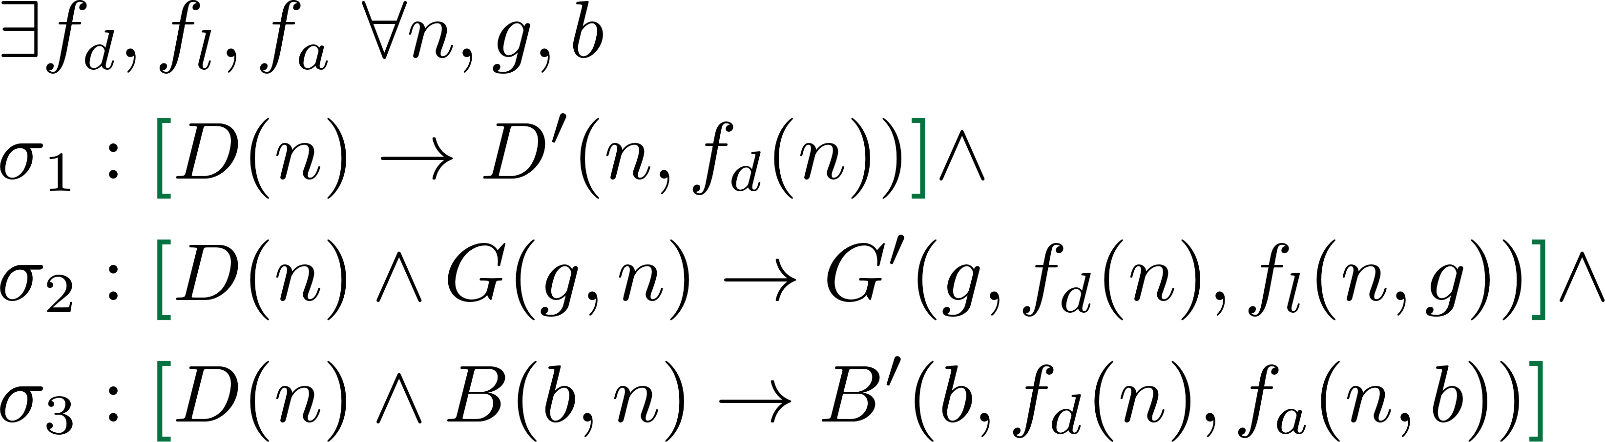
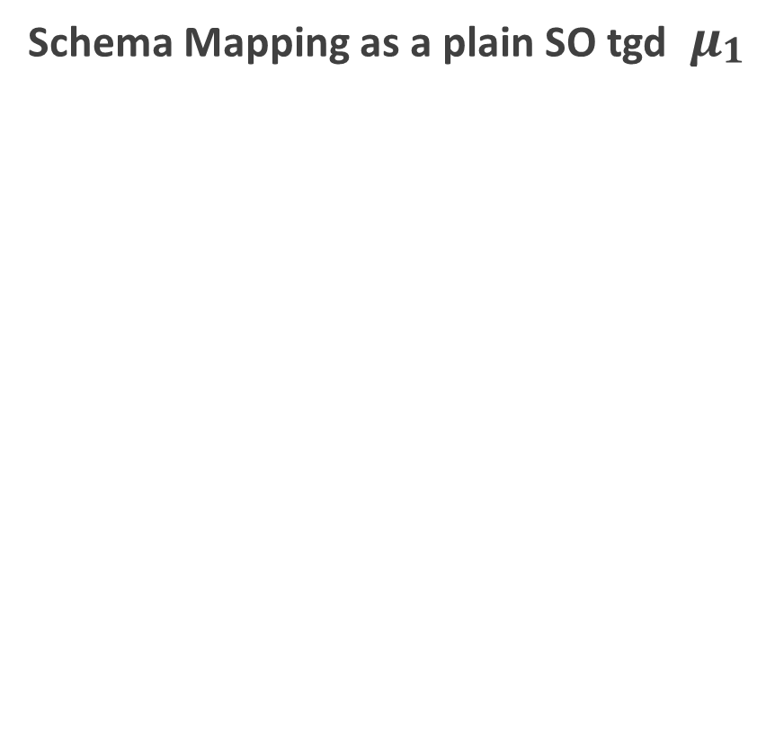
Running Example
Source Schema
Target Schema
Schema Mapping as a plain SO tgd ${ μ}_{\begin{aligned}1 \\ \end{aligned}}$
Department
DeptName
“Finance“
Department
DeptName | DeptID
“Finance“
Group
GroupID | DeptName
10005 | “Finance“
Group
GroupID | DeptID | Leader
10005
Budget
BudgetID | DeptName
10006 | “Finance“
Budget
BudgetID | DeptID | Amount
10006
Notes:
∃${\text{f}}_{d}$, ${\text{f}}_{l}$, ${\text{f}}_{a}$,
$σ_{1}:$∀n, g, b [D(n) $→$ D’(n)]

Slide 5




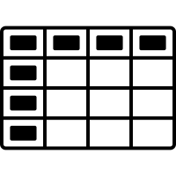


Our Use Case: Schema Mapping for Heterogeneous Data Lakes
A data lake is a big data repository [SIGMOD16]:
Heterogeneous data ingestion in raw structures (Load-As-Is)
Hybrid data store (Polystore)
Interfaces to explore and to query data and metadata
Provide ad-hoc data integration, (later) transformation, and cleaning
On-the-fly mapping generation
Business Report
Social Media
Scientific Data
Sensor Data
Data Lake
Partially Integrated Schema
DS1
DS2
Data Lake User
JSON
DS3
{
K
:
Schema Mappings
V
}
Application-specific
Data Marts

Slide 6

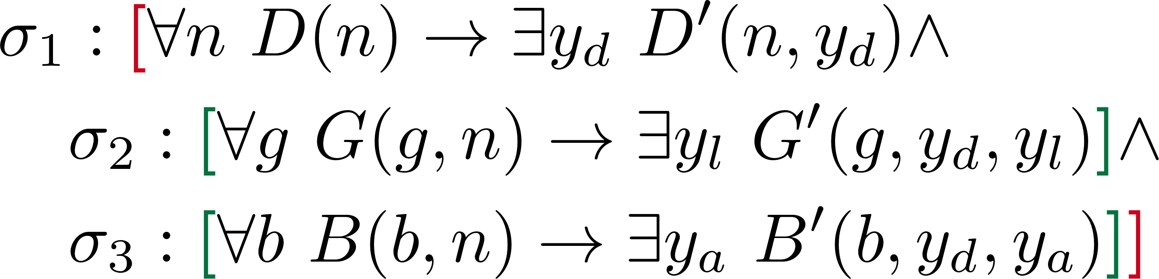
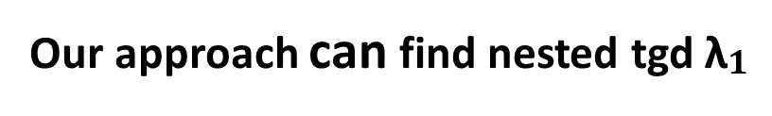
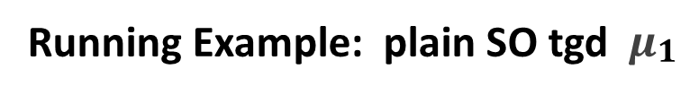
Research Questions
Q1: Given a schema mapping expressed as a plain SO tgd μ, is there a single nested tgd λ or a set of nested tgds Λ logically equivalent to μ?
Existing approaches [Nash2007, Pichler2011, Arocena2013]
Based on de-Skolemization:
Consider only Skolem functions: ordering of the arguments
Limitations:
Hierarchical structure not considered
Multiple alternatives not considered
Running Example: plain SO tgd ${ μ}_{\begin{aligned}1 \\ \end{aligned}}$
Our approach can find nested tgd ${\text{λ}}_{\begin{aligned}1 \\ \end{aligned}}$
No containment relationship
Skolem functions cannot be ordered
Not rewritable by existing works
Notes:
[Nash et al., 2007; Pichler and Skritek, 2011].

Slide 7
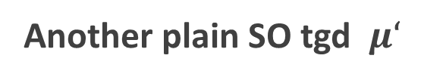

Research Questions
Q2: How can we characterize the class of plain SO tgds, for which a rewriting to nested tgds is possible?
Schema Mapping as a plain SO tgd ${ μ}_{\begin{aligned}1 \\ \end{aligned}}$
Another plain SO tgd ${ μ‘}_{\begin{aligned} \\ \end{aligned}}$

Slide 8
Research Questions
Q3: Can we define and implement an efficient algorithm that is able to translate a relevant subset of plain SO tgds into logically equivalent nested tgds?
Q4: How can we evaluate the correctness, completeness, and performance of the algorithms to rewrite plain SO tgds into nested tgds?

Slide 9
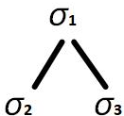
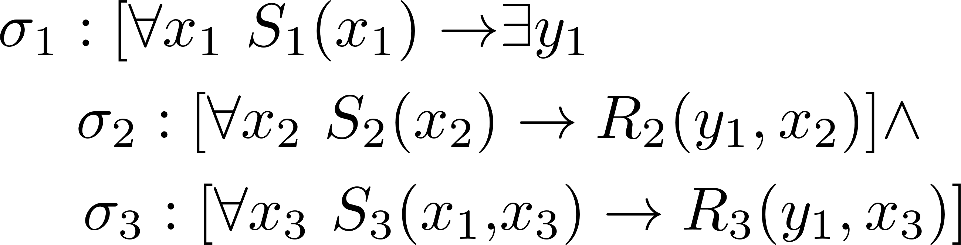
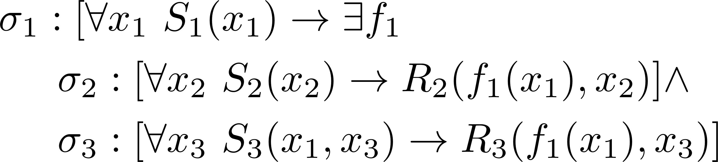
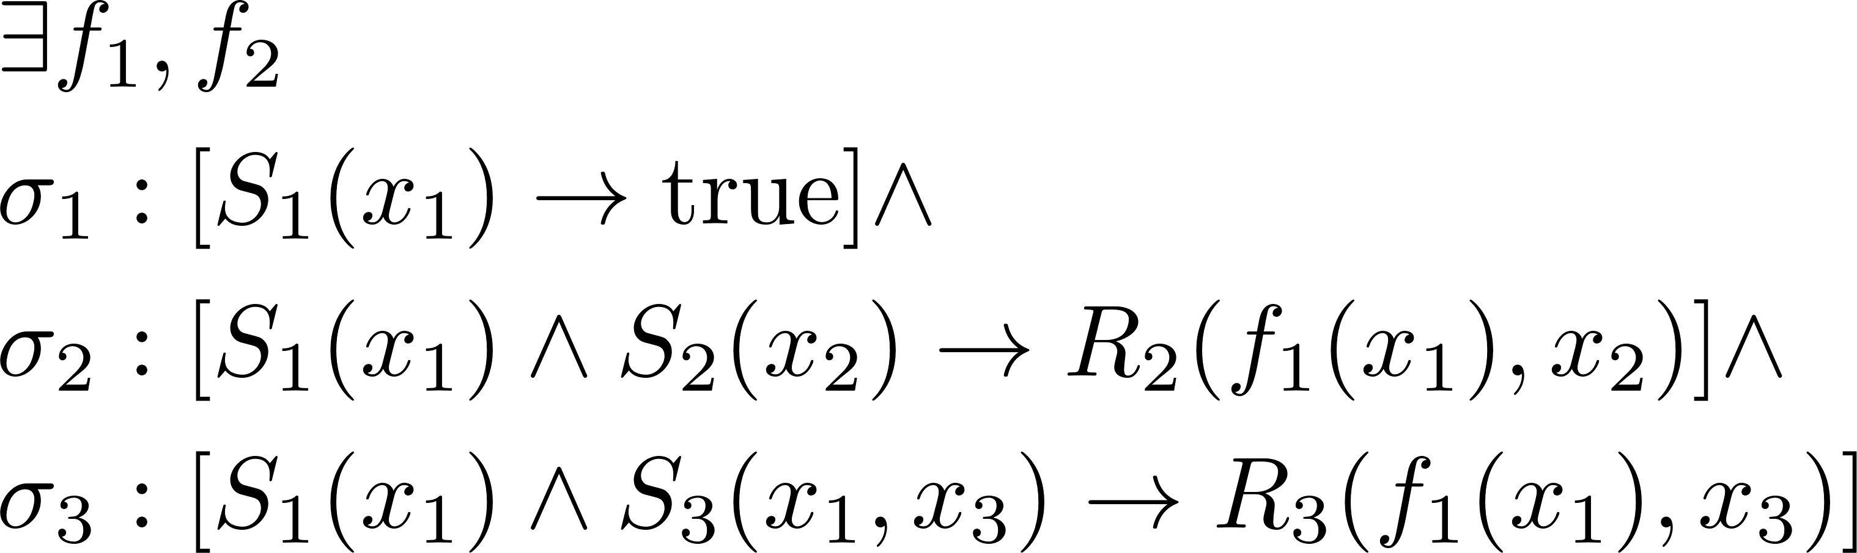
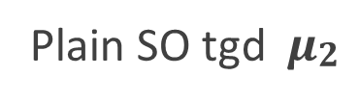

Intuition: from nested tgd to plain SO tgd
Two transformations: preserve logical equivalence [Kolaitis2014, Gottlob2015]
Nested tgd ${\text{λ}}_{2}$ and its Pattern
Skolemized nested tgd
Skolemization
Plain SO tgd ${ μ}_{\begin{aligned}2 \\ \end{aligned}}$
Normalization

Slide 10
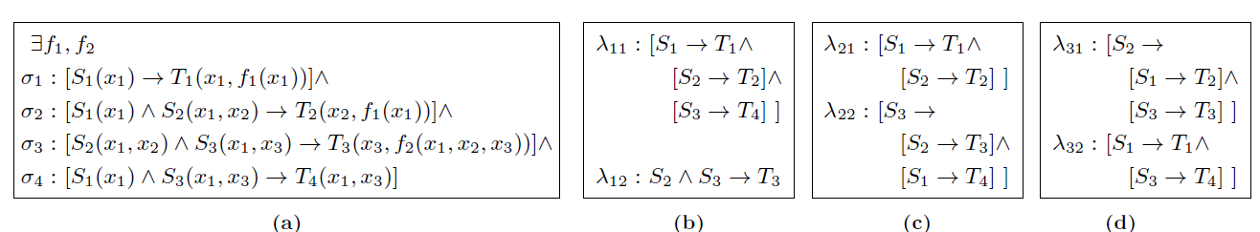
Our Approach: rewrite plain SO tgds (Q1)
Goals:
Find solutions: one or a set of nested tgds
Each solution equivalent to input plain SO tgd (correctness)
Procedure
Reverse Normalization (Multiple alternatives are possible)
Reverse Skolemization (Deskolemization)

Slide 11
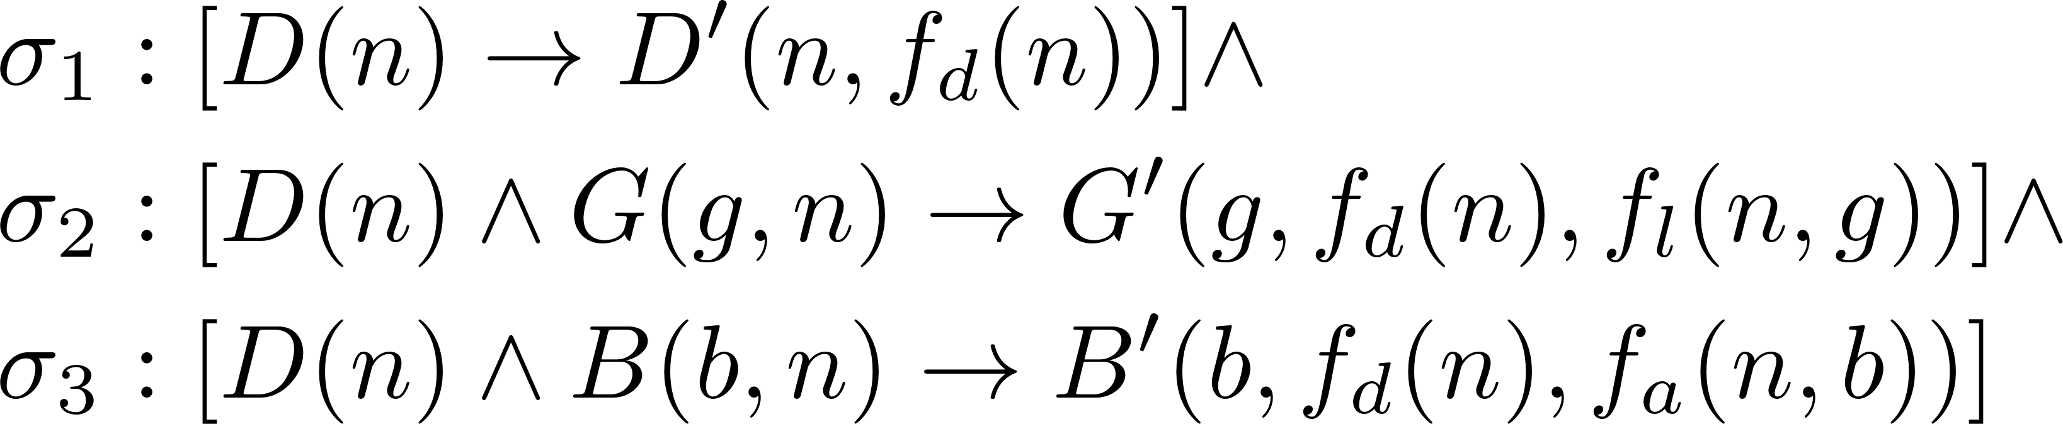
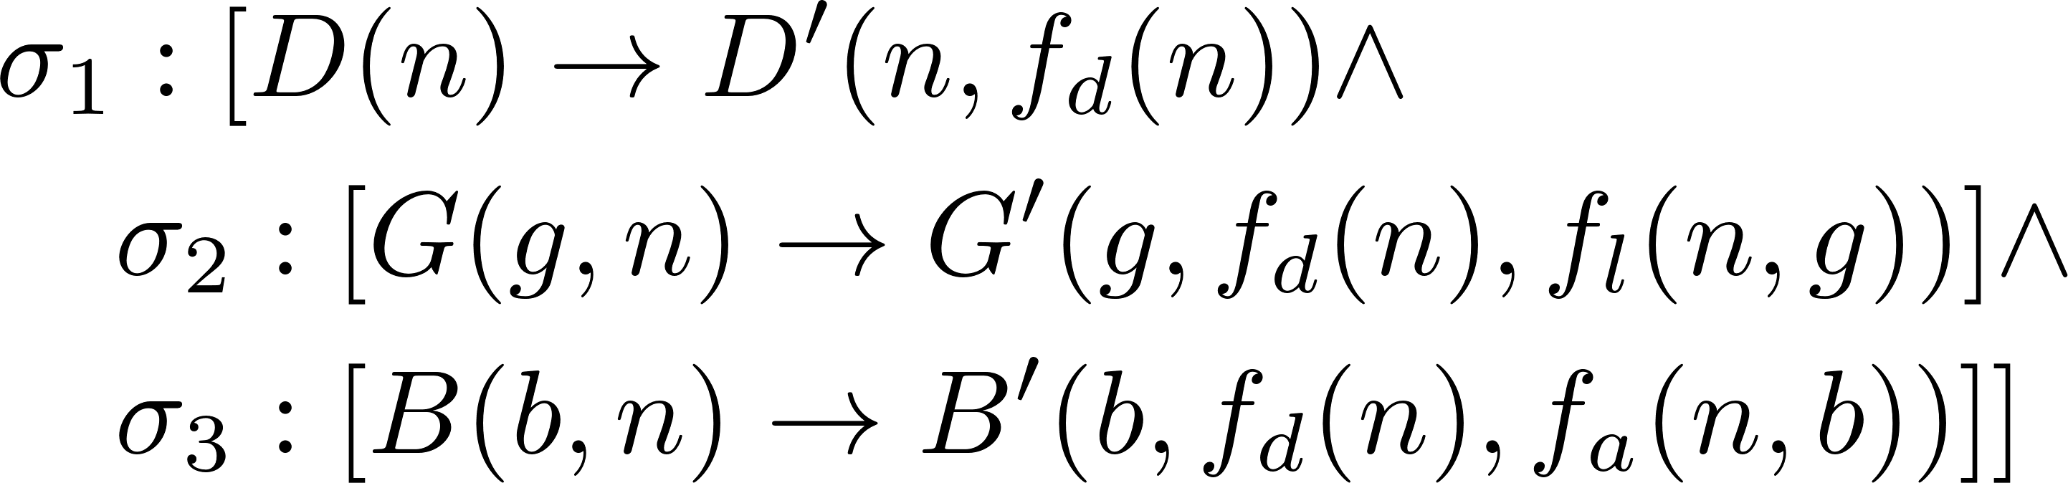
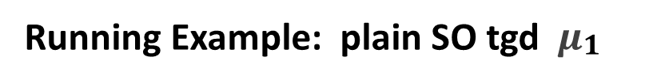
Our Approach
Step 1: Reverse Logical Normalization
Running Example: plain SO tgd ${ μ}_{\begin{aligned}1 \\ \end{aligned}}$
Algorithm Nest
D
G
B

Slide 12
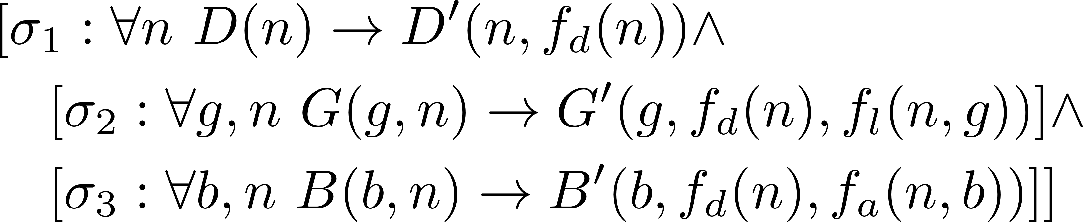
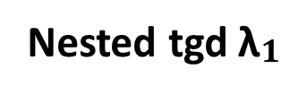
Our Approach
Step 2: Reverse Skolemization, for each Skolem function
Find the first part where it appears
Check arguments
D
Algorithm Deskolemization
f_{d}(n)
G
B
Nested tgd ${\text{λ}}_{\begin{aligned}1 \\ \end{aligned}}$
f_{l}(n,g)
f_{a}(n,b)

Slide 13
Our Approach: Rewritability Conditions (Q2)
An input plain SO tgd has equivalent nested tgds if it is:
Consistent [Nash2007]
Skolem functions have the same list of arguments
No repeated variables in Skolem function arguments
Hierarchically-Ordered
A set of tree structures implied by source relations (LH-Skolem-trees T)
Distinct trees in T have disjoint Skolem functions
Skolem function arguments match the LH-Skolem-trees T
D
f_{d}(n)
G
B
f_{l}(n,g)
f_{a}(n,b)

Slide 14
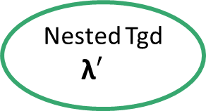

Evaluation Results
Input mappings:
Nested Tgd Generator
Plain SO tgd Generator
Generate Transformed Plain SO tgd (Rewritability known)
Nested Tgd Generator
Skolemize + Normalize
Nested Tgd ${\text{λ}}_{\begin{aligned} \\ \end{aligned}}$
(Transformed) Plain SO tgd 𝝁
Very structural homomorphism
Input
Nested Tgd ${\text{λ}′}_{\begin{aligned} \\ \end{aligned}}$
Our rewriting algorithm
Output

Slide 15

Evaluation Results
Input mappings:
Nested Tgd Generator
Plain SO tgd Generator
Generated Plain SO tgd (Rewritability unknown)
Plain SO tgd Generator
Plain SO tgd 𝝁
Our rewriting algorithm
Input
Output
Verify structural homomorphism
Skolemize + Normalize
Plain SO tgd 𝝁’
Nested Tgd ${\text{λ}}_{\begin{aligned} \\ \end{aligned}}$

Slide 16
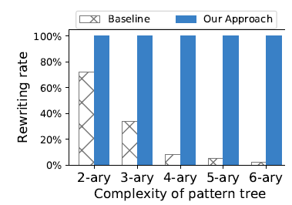
Evaluation Results
Input mappings:
Nested Tgd Generator
Plain SO tgd Generator
Our approach is sound
Existing literatures
1,088,230 generated mappings
Baseline comparison [Arocena2013]
Higher Rewritability
Rewritability not affected by mapping nesting complexity

Slide 17
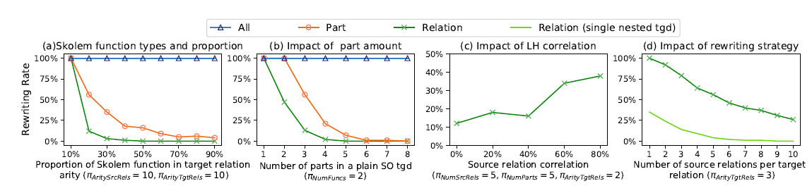
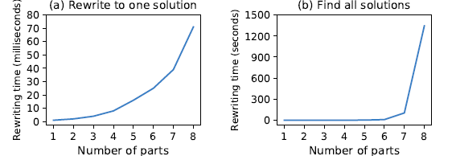
Evaluation Results
Rewritability is a complex problem
Skolem functions types and proportion
Number of parts
Source relation correlation
Rewriting strategies: one or a set of nested tgds
Performance
Efficient for one valid solution of rewritable plain SO tgds
Exponential complexity for all possible solutions
Exponential complexity for non-rewritable plain SO tgds

Slide 18
Conclusion
An algorithmic approach to transform plain SO tgds to one or a set of equivalent nested tgds
A sufficient condition to tell whether the input plain SO tgd is rewritable
Intensive experiments: correctness, completeness and performance of our approach
Future directions
Apply (relaxed) functional dependencies [ER’19]
Connect with other mapping tasks in data lakes [SIGMOD’16]

Slide 19
References
[Nash2007] Nash, A., Bernstein, P. A., and Melnik, S. (2007). Composition of mappings given by embedded dependencies. ACM Transactions on Database Systems (TODS), 32(1):4, 2007.
[Pichler2011] Pichler, R. and Skritek, S. (2011). The complexity of evaluating tuple generating dependencies. In Proceedings of the 14th International Conference on Database Theory (ICDT), pages 244-255. ACM.
[Arocena2013] Arocena, P. C., Glavic, B., and Miller, R. J. (2013). Value invention in data exchange. In Proceedings of the 2013 ACM SIGMOD International Conference on Management of Data (SIGMOD), pages 157-168. ACM.
[Quix2016] Quix, C., Hai, R., & Vatov, I. (2016). Metadata extraction and management in data lakes With GEMMS. Complex Systems Informatics and Modeling Quarterly, (9), 67-83.
[Hai2016] Hai, R., Geisler, S., and Quix, C. (2016). Constance: An Intelligent Data Lake System. In Proceedings of the 2016 International Conference on Management of Data (SIGMOD), pages 2097-2100. ACM.
[Jarke 2017] Jarke, M., & Quix, C. (2017). On warehouses, lakes, and spaces: the changing role of conceptual modeling for data integration. In Conceptual Modeling Perspectives (pp. 231-245). Springer, Cham.
[Hai2018a] Hai, R., Quix, C., and Kensche, D. (2018a). Nested schema mappings for integrating JSON. In International Conference on Conceptual Modeling (ER), volume 11157, pages 397-405S, pringer, Cham..
[Hai2018b] Hai, R., Quix, C., and Zhou, C. (2018b). Query Rewriting for Heterogeneous Data Lakes. In European Conference on Advances in Databases and Information Systems (ADBIS), volume 11019, pages 35-49, Springer, Cham.
[Hai2019] Hai, R., Quix, C., and Wang, D. (2019). Relaxed Functional Dependency Discovery in Heterogeneous Data Lakes. In International Conference on Conceptual Modeling (ER).

Slide 20
Q&A
Running Example: plain SO tgd ${ μ}_{\begin{aligned}1 \\ \end{aligned}}$
Nested tgd ${\text{λ}}_{\begin{aligned}1 \\ \end{aligned}}$
D
f_{d}(n)
G
B
f_{l}(n,g)
f_{a}(n,b)

Slide 21
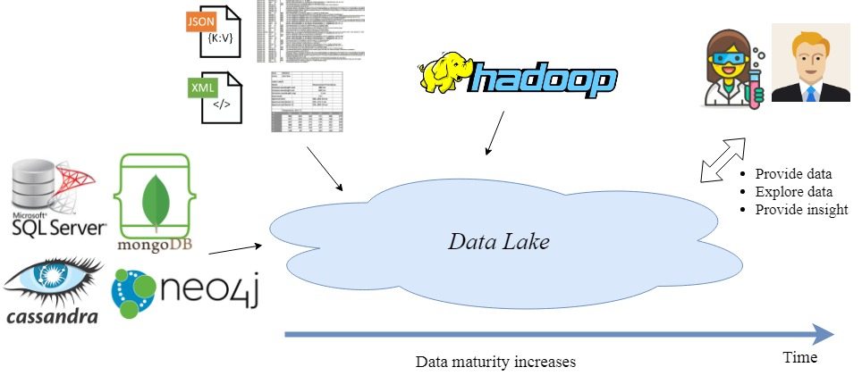
Background: Data Lakes
Data Lake as a black box
Big Data repositories supporting multiple sources
Heterogeneous data ingestion in original structures (Load-As-Is)
Heterogeneous, hybrid data store
Described by metadata
Schema-on-read
Provide data integration, transformation, and cleaning
Interfaces to explore and to query data and metadata
Notes:
A data lake is a data repository in which datasets from multiple sources are stored in their original structures. It should provide functions to extract data and metadata from heterogeneous sources and to ingest them into a hybrid storage system. In addition, a data lake should offer a data transformation engine, in which datasets can be transformed, cleaned, and integrated with other datasets. Finally, interfaces to explore and to query the data and metadata of a data lake should be also available in a data lake system.

Slide 22
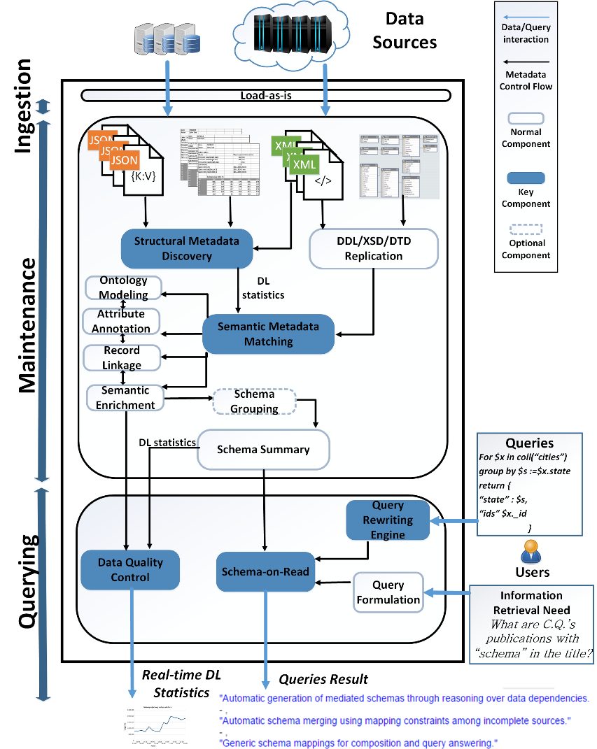

How to get data into the data lake?
Constance [Hai et al., 2016; Hai et al., 2018a]
Ingest heterogeneous data
Data stored in RDBMS & NoSQL
Data Connectors based on Spark
(built-in) Java Database Connectivity (JDBC) interface
Spark-MongoDB-Connector
Spark-Neo4j-Connector

Slide 23
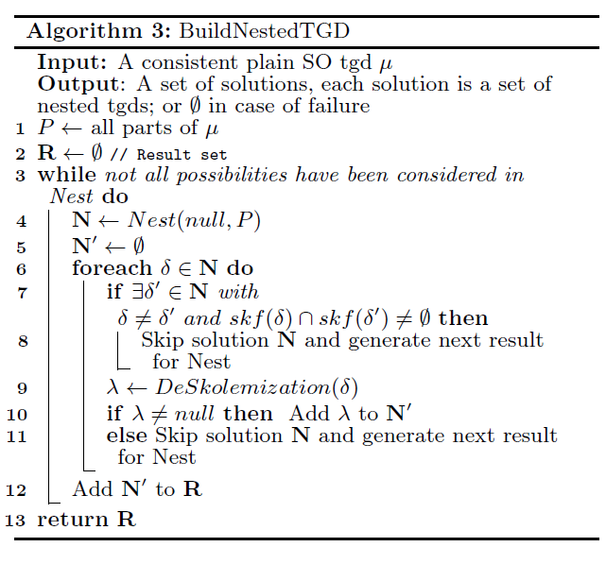
Our Approach: Algorithms

Slide 24
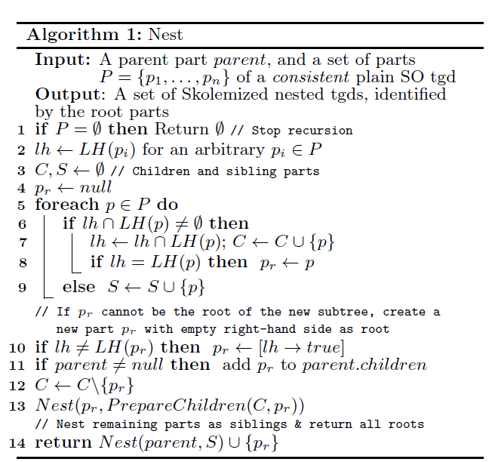
Our Approach: Algorithms

Slide 25
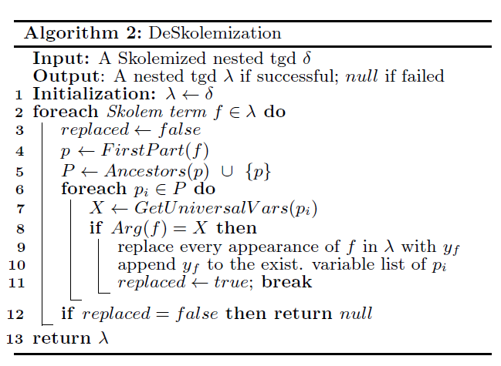
Our Approach: Algorithms

Slide 26
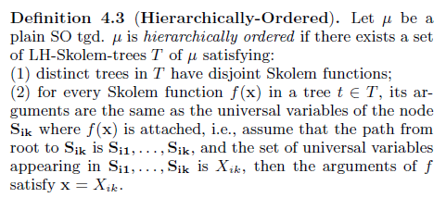

Our Approach: answering Q2
An input plain SO tgd has equivalent nested tgds if:

Slide 27
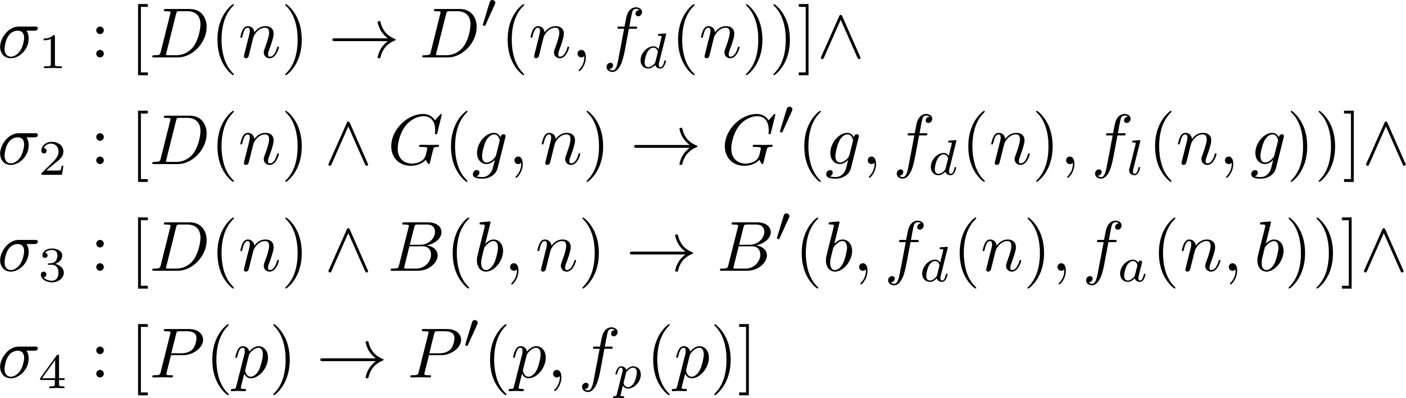

Slide 28


Nested Tgd Generator
Skolemize + Normalize
Nested Tgd ${\text{λ}}_{\begin{aligned} \\ \end{aligned}}$
(Transformed) Plain SO tgd 𝝁
Very structural homomorphism
Input
Nested Tgd ${\text{λ}′}_{\begin{aligned} \\ \end{aligned}}$
Our rewriting algorithm
Output

Slide 29

Plain SO tgd Generator
Plain SO tgd 𝝁
Our rewriting algorithm
Input
Output
Verify structural homomorphism
Skolemize + Normalize
Plain SO tgd 𝝁’
Nested Tgd ${\text{λ}}_{\begin{aligned} \\ \end{aligned}}$

